Slide 1


Airport Research for Simulation Project based on ARENA
Yanxi Li
yli130@kent.edu
05/10/2021

Slide 2

Introduction
The check-in and security process usually takes much time for passengers which can cause congestion in the airport and more severely, even make the passengers delayed.
Balance the Resource Number in each Station/Process is quite essential.

Slide 3
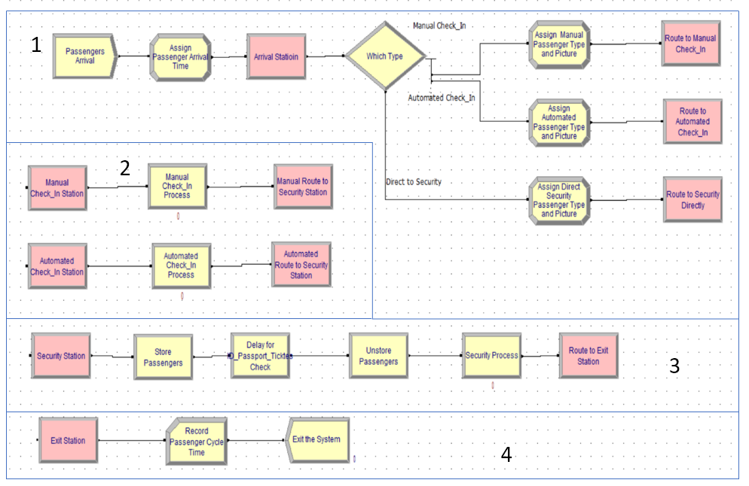
Simulation Configuration
Arrival Station
Check-in Station
Manual Check-in
Automated Check-in
3. Security Station
4. Exit Station

Slide 4
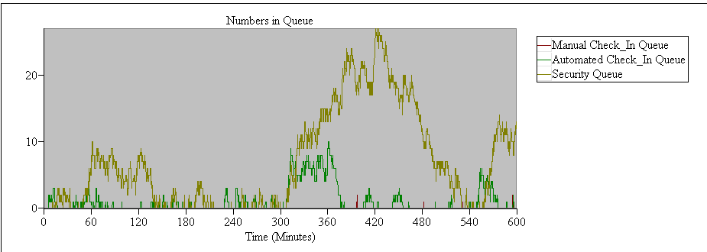
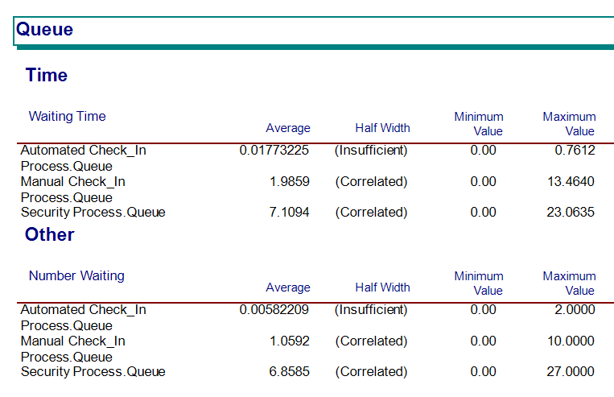
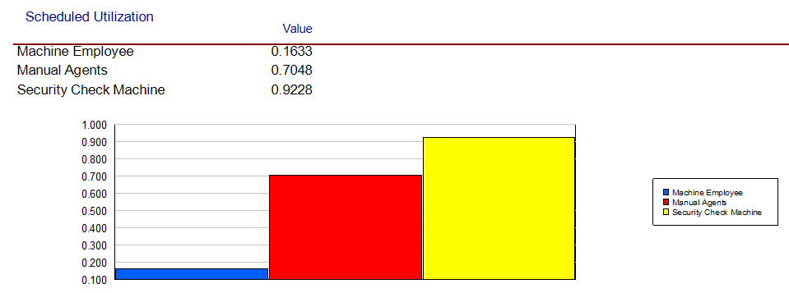
Original Result
Number of Resource People :
Manual Check-in : 2
Automated Check-in : 2
Security : 3
Security Queue increase a lot at the beginning of 300 minutes.
Security Process Queue average waiting time is longer.
Compared to the other 2 resources, Automated Resource Utilization is lower.

Slide 5
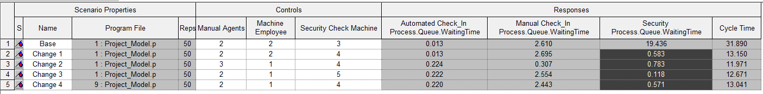
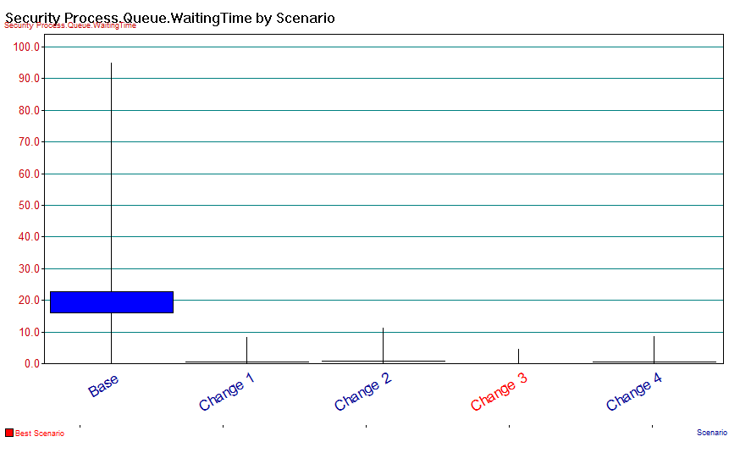
Model Improvement
Process Analyzer
Compare results with different resources number in each station.
Resource number for 2-1-4 is the best.

Slide 6
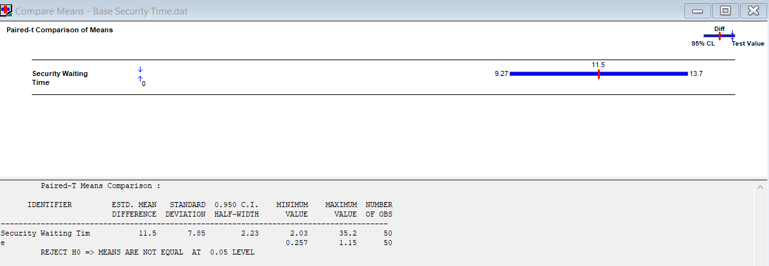
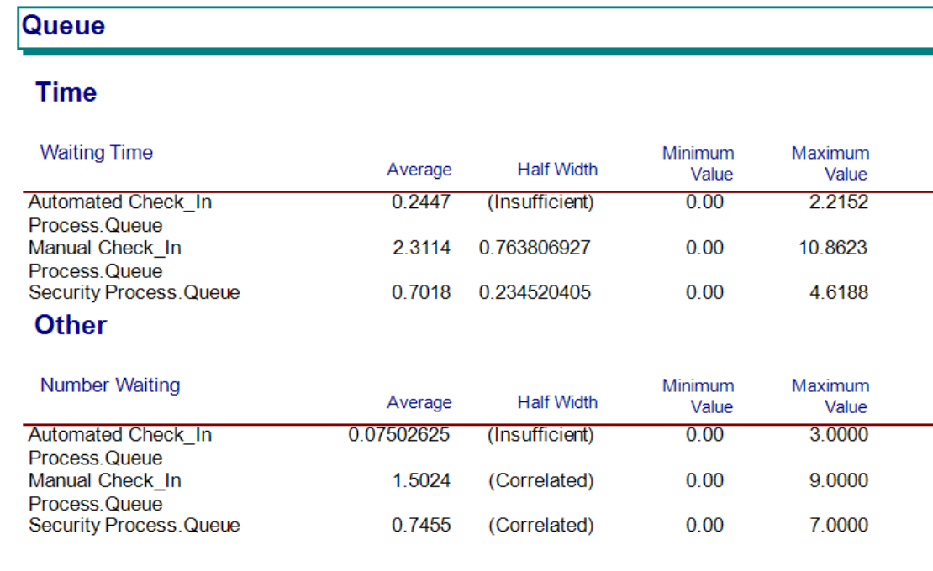
Improve Result
Moving one Resource from Automated check-in Station to Security Station can efficiently reduce the Security average waiting time.

Slide 7
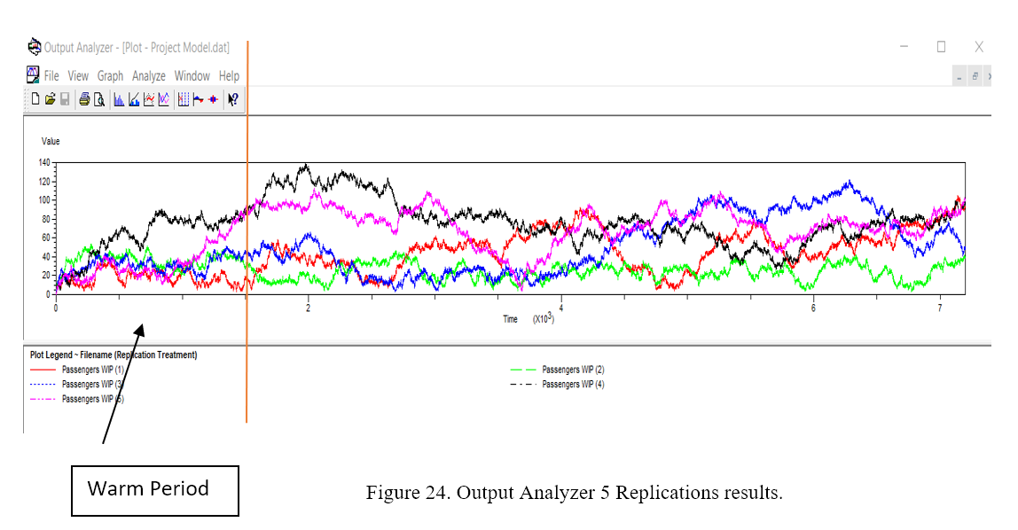
Discussion
Terminating State : model has specific starting and stopping conditions.
Steady State : model is defined in the long run, theoretically infinite time.
Consider Warm Period

Slide 8
Conclusion
Changing each station resources number to get less waiting time for passengers is essential.
Improving the original model by changing the one Resource from Automated check-in Station to Security Station.
In the real system, the model can be much more complicated, additional effort will also be included like considering the warm period.

Slide 9

Thanks for watching!

